Slide 1
Case Study: Nkululeko High School (2012 Project School)

Slide 2
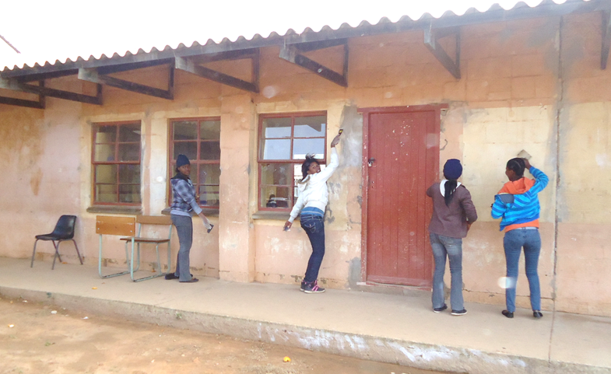
Our first visit …
Run down and vandalized
Litter everywhere
Broken windows
Broken doors
Holes in ceilings
No staff room
OUR AIM:
P.a.s.S.P.O.R.T.

Slide 3
Where do we start?
A despondent group...
Dr Walter: “ we can leave…give up … go back to our comfortable lives … OR

Slide 4
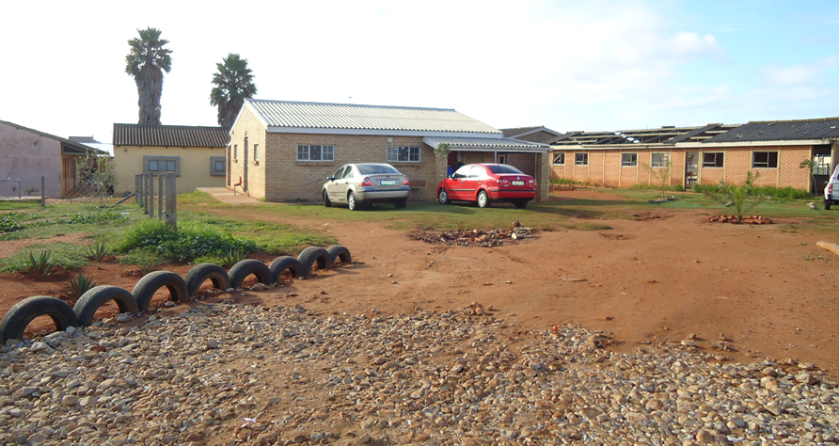
“Our school has been vandalized and we would really like the community to get more involved and support us….Your project would be beneficial for our L.O teachers and help us to improve our pupil’s fitness level.”
Mrs Stokwe, principal
The schools’ attempts
Improved security – fencing
Caretakers’ cottage on premises
Garden started
Selected teachers painted their class rooms at their own expense
gained recognition in soccer, and netball
Award winning choir

Slide 5
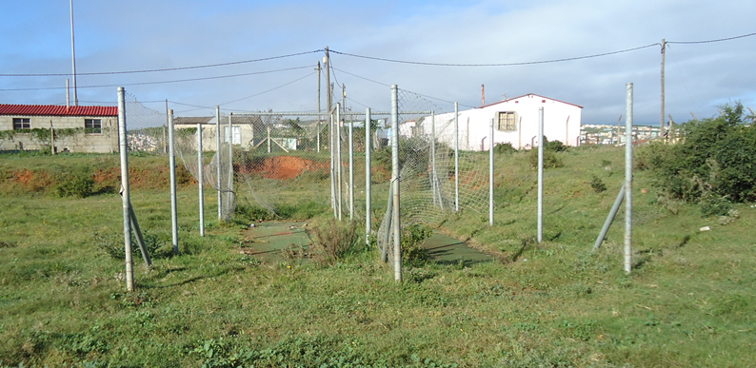
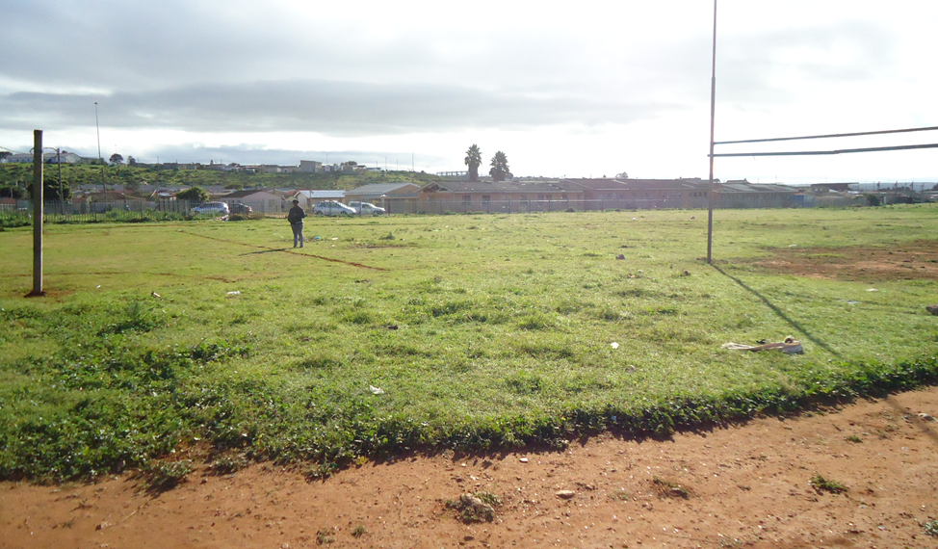
Our intervention
11 HMS Students
Find sponsors: aim to raise R10 000

Slide 6
What we did
Needs analyses
Researched the intervention
Main idea: Convert derelict classroom into an improvised gym
Presented our ideas to the staff and SRC
Funding Proposal
Obtained sponsors
Organize a Spring Day Clean-up

Slide 7
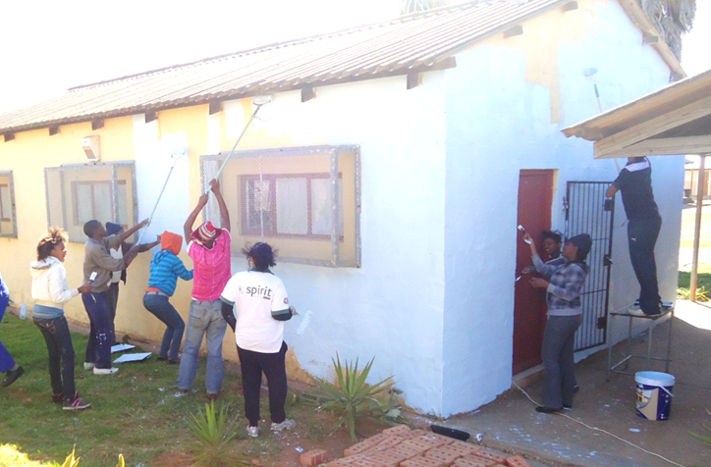
Saturday, 1 September 2012
800 litres of paint sponsored
5 teachers and more than 100 children came for the Spring Day clean-up: scrapping, painting …
Principal, Mrs Stokwe and mothers cooked a meal for everyone
HMS students worked on the “gym”

Slide 8
A transformed School

Slide 9
The improvised “gym”

Slide 10
The improvised “gym”

Slide 11
The improvised “gym”

Slide 12
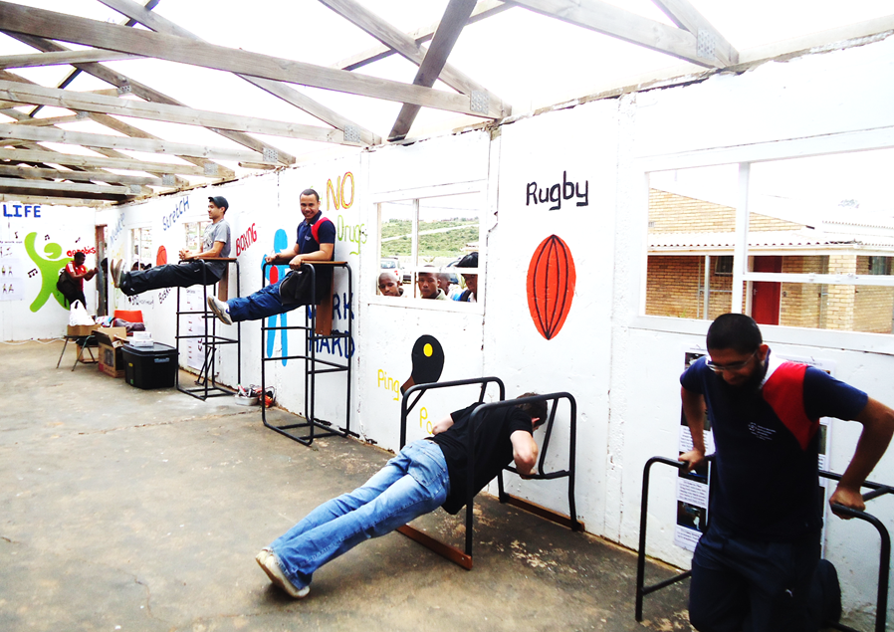
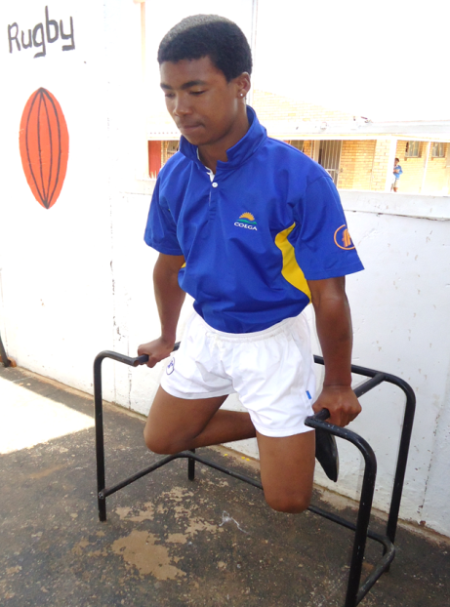
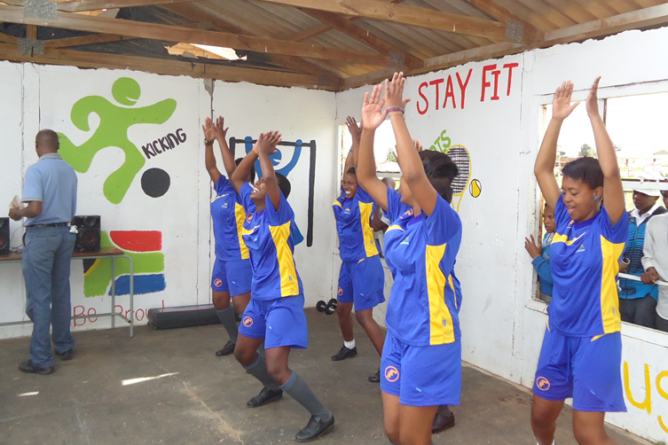
The improvised “gym”

Slide 13
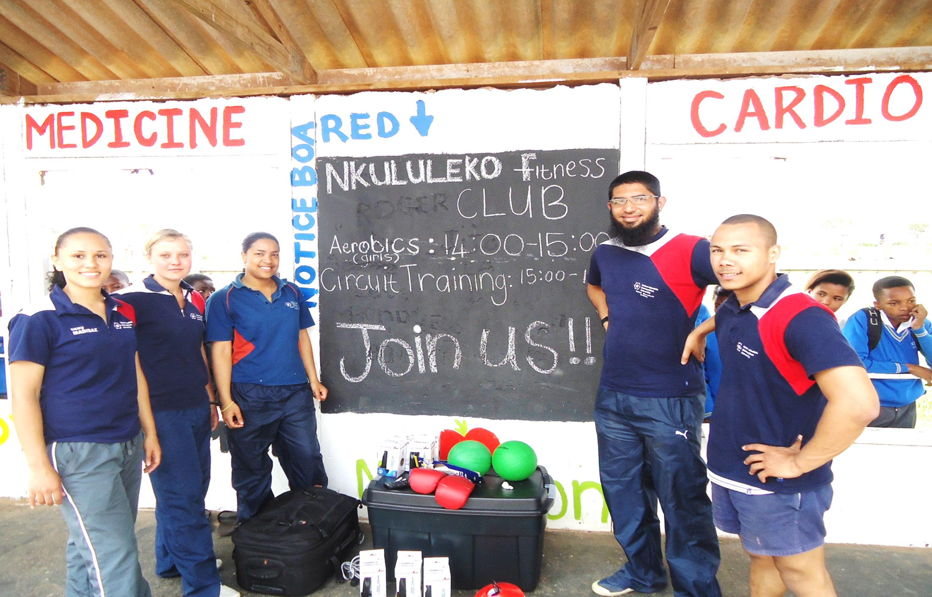

Slide 14
Challenges Rewards
Shocking state of disrepair of the school
Finding a suitable intervention
Group dynamics at the beginning
Finding sponsors
Satisfaction of achieving something good
Seeing the end result
Made a difference to a school in great need
Appreciation for learners and teachers

Slide 15
Publicity

Slide 18
